Slide 1

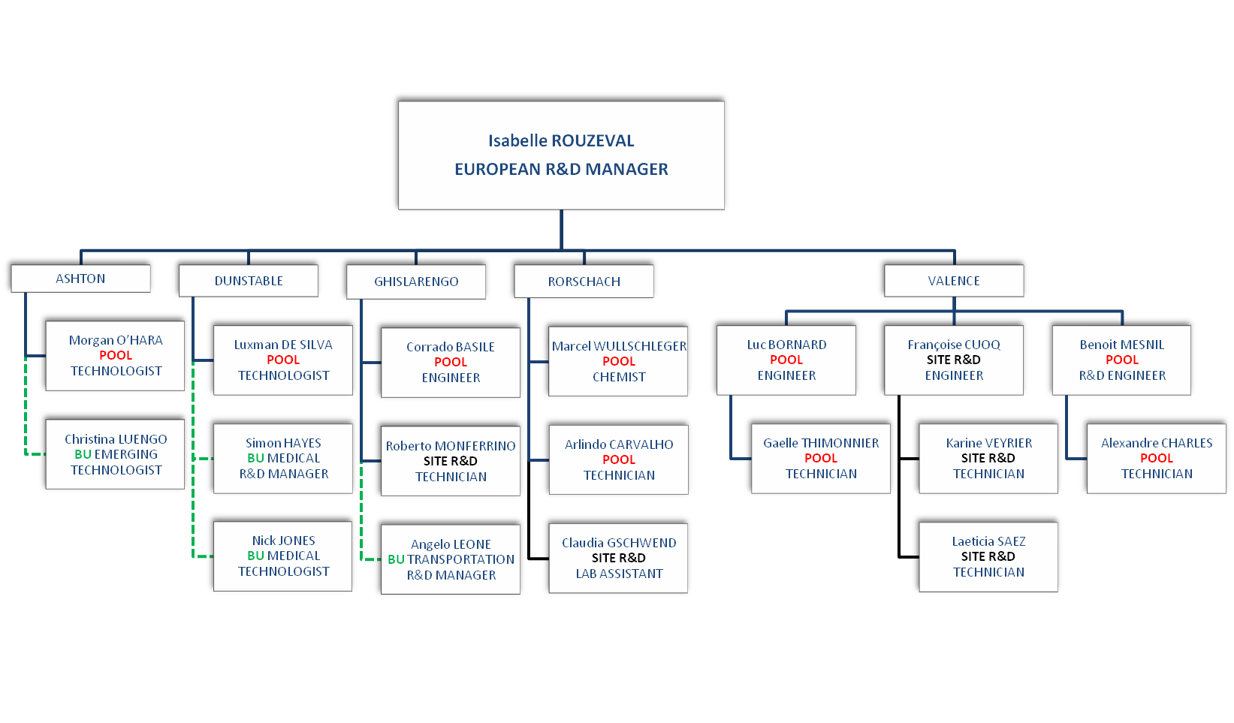
EUROPEAN R&D DEPARTMENT
Dot-line with European R&D Manager and Direct report to Business Unit Leader
SCAPA EUROPE mars 2010
Notes:
Documentinterne Scapa France. Mise à jour : novembre 2009

Slide 2
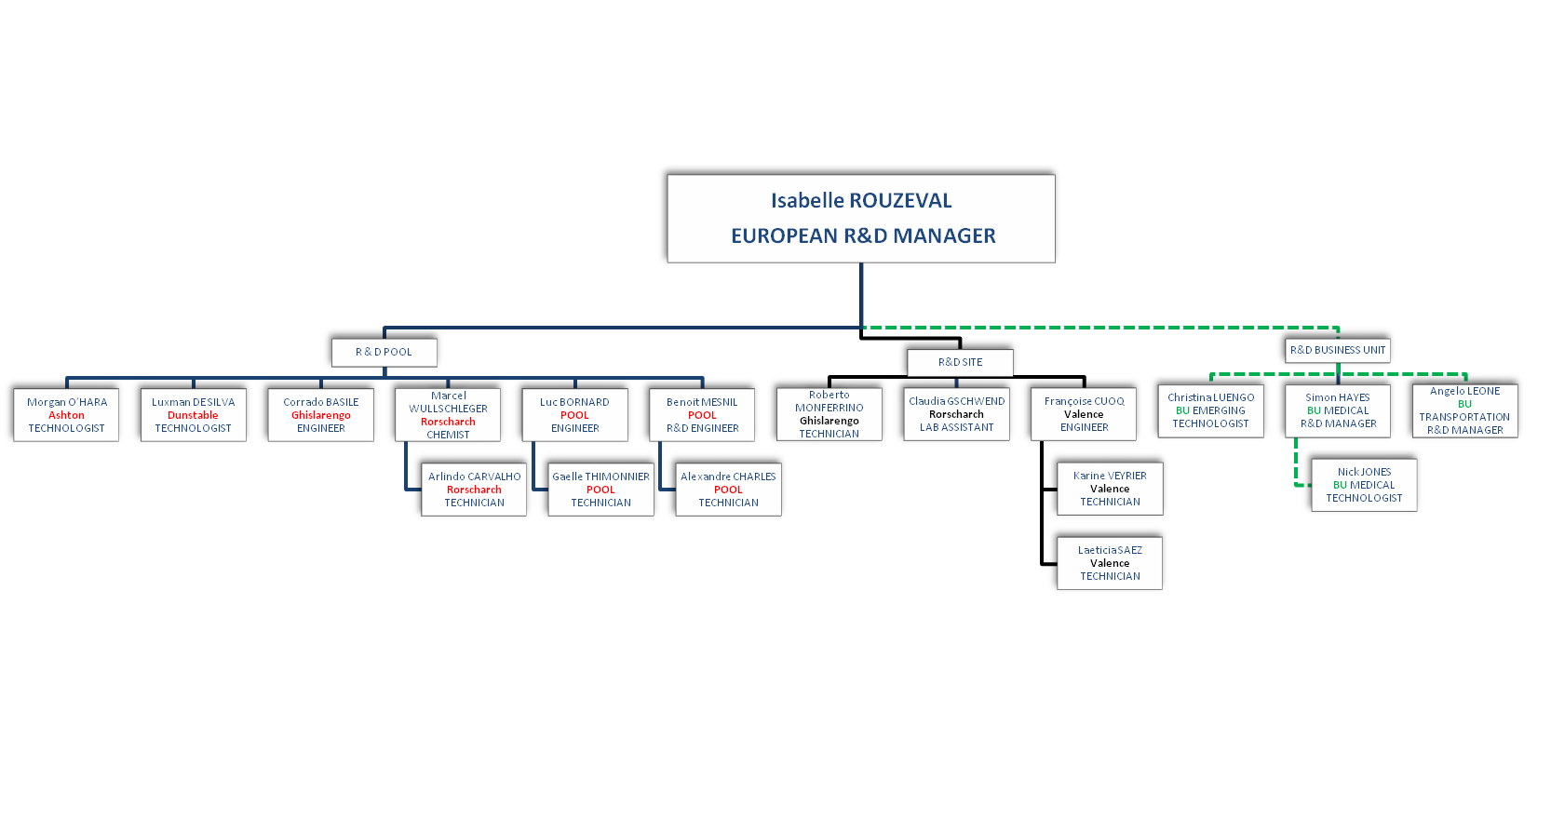
EUROPEAN R&D DEPARTMENT
Dot-line with European R&D Manager and Direct report to Business Unit Leader
SCAPA EUROPE mars 2010
Notes:
Documentinterne Scapa France. Mise à jour : novembre 2009

